Slide 1
Teaching U.S. Environmental History to STEM (and History) Majors at CSULB
Nancy Quam-Wickham

Slide 2
“Cognitive Constraints”

Slide 3
Strategies for Meaningful Teaching and Learning
Establish a baseline: student goals & characteristics
Utilize specificity in scientific concepts for definitional purposes
Employ a range of disciplinary practices of historians

Slide 4
Strategies for Meaningful Teaching and Learning
Use historical data to enhance understanding of current issues
Acknowledge that both disciplines (history and science) bring value to the field of EH
Exploit recognized high-impact pedagogical practices
Notes:
Here, I use AAC&U’s definition of high impact pedagogical practices

Slide 5
Definitions: Deepening STEM students’ disciplinary knowledge through historical inquiry

Slide 6
Employ methods of historians
Interrogate meaning of “conservation” and “natural”
Introduce human society and agency into a narrative of “protecting Nature”
Mark Spence, Dispossessing the Wilderness: Indian Removal and the
Making of the National Parks

Slide 7
Use historical data to enhance knowledge of current issues
Notes:
Issue of importance to students at “The Beach” – how has our coastline changed? Breakwater elimination?

Slide 8
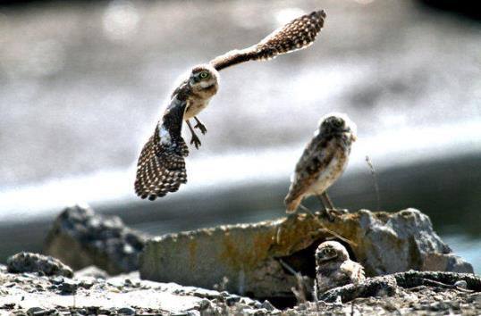
Acknowledge contributions of science and history to the field
What role does human activity play in reestablishing species?
Notes:
particularly the organization & reorganization of space: reclamation of wetlands, militarization of southern California, idea of accessible “open space”

Slide 9
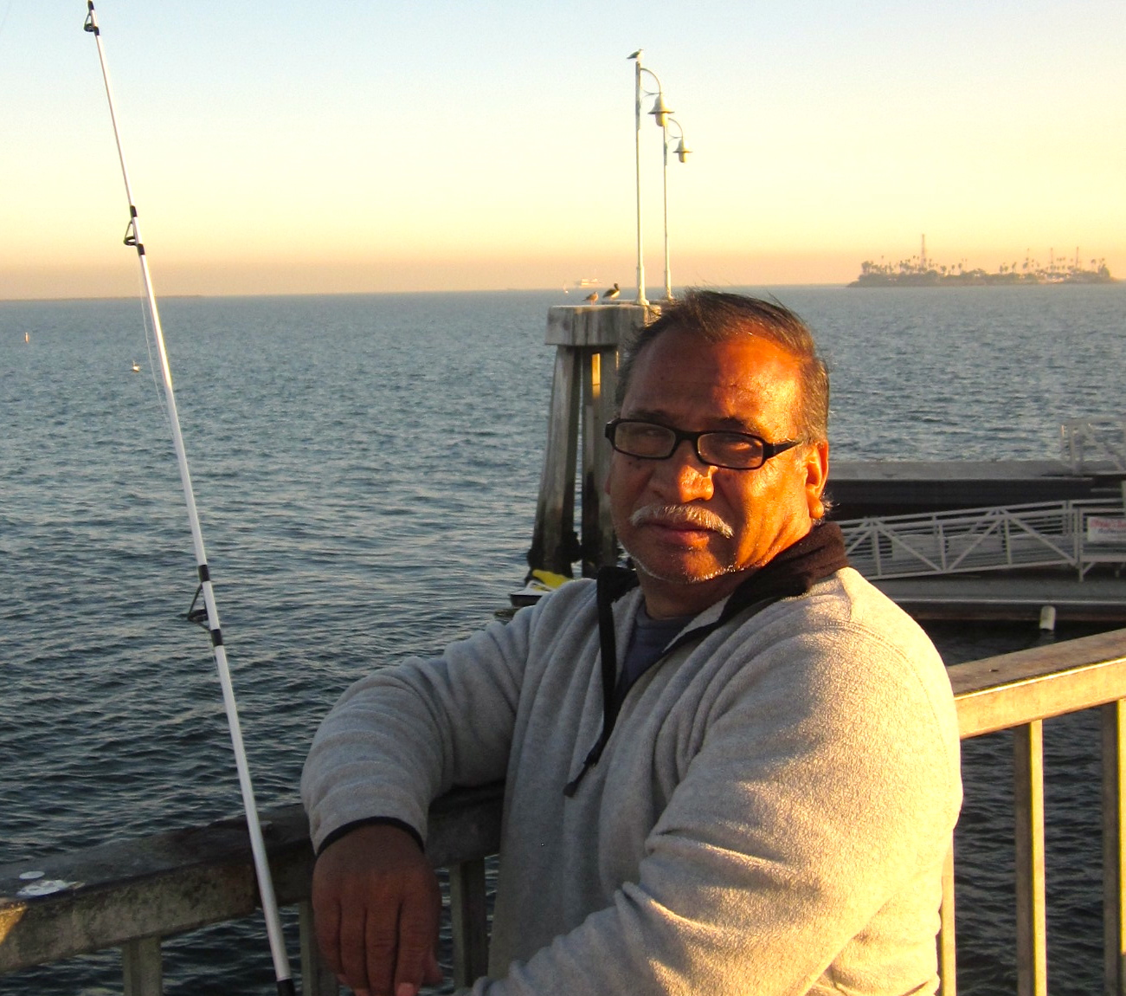
Use high-impact practices: Collaborative Inquiry
Field inquiry: Environmental Inequality
Notes:
Exercise: Find local example of environmental inequality: Who fishes in the polluted waters of Long Beach?

Slide 10
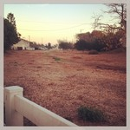
Use high-impact practices: Undergraduate Research
Field Research: Environmental Planning
Notes:
Planning: Transformation of space – old Pacific Electric interurban railway right of way – where are the fruit trees for the poor and homeless?

Slide 11
Use high-impact practices: Service Learning
Notes:
EX: Work for Algalita Marine Research Foundation – sampling techniques: counting microscopic plastic fragments from Great N.P garbage patch

Slide 12
Service Learning: FOLAR

Slide 13
Additional Service Learning sites

Slide 14
Service Learning Placements to suit career goals and skills

Slide 15
Benefits
Appreciation of disciplinary methods
Community engagement
Reflective assignments ➔ self-awareness
Closer alignment of outcomes
Re-conceptualize EH as a field
Notes:
Understanding of what each practitioner does leads to better understanding of complexity of environmental issues & thus EH; community engagement helps students see themselves as contributing members of society & hopefully helps them become better citizens; reflective assignments (What is your favorite natural space?) leads them to become more self-aware and understand interrelationships; alignment of LEAP, GE, course, and PLOs; reconceptualize EH as URBAN EH – we’re an urban society!

