Slide 1
A Pre-Major for History: The What and the Why
Dan McInerney
Tuning USA Advisory Board
Professor & Associate Department Head
Utah State University, Department of History
daniel.mcinerney@usu.edu

Slide 2
HISTORY PRE-MAJOR
Students who wish to become History majors must apply for admission after completing the Department’s 30-credit pre-major program.
Provides a set of “foundation courses” in 3 areas:
(1) Surveys of Western civ, World history, and U.S. history;
(2) General Education classes that provide
a strong background to historical studies;
(3) University “competency” courses
(writing/math)
all of which prepare students for upper-division work in the major.

Slide 3
The reasoning
behind the pre-major

Slide 4
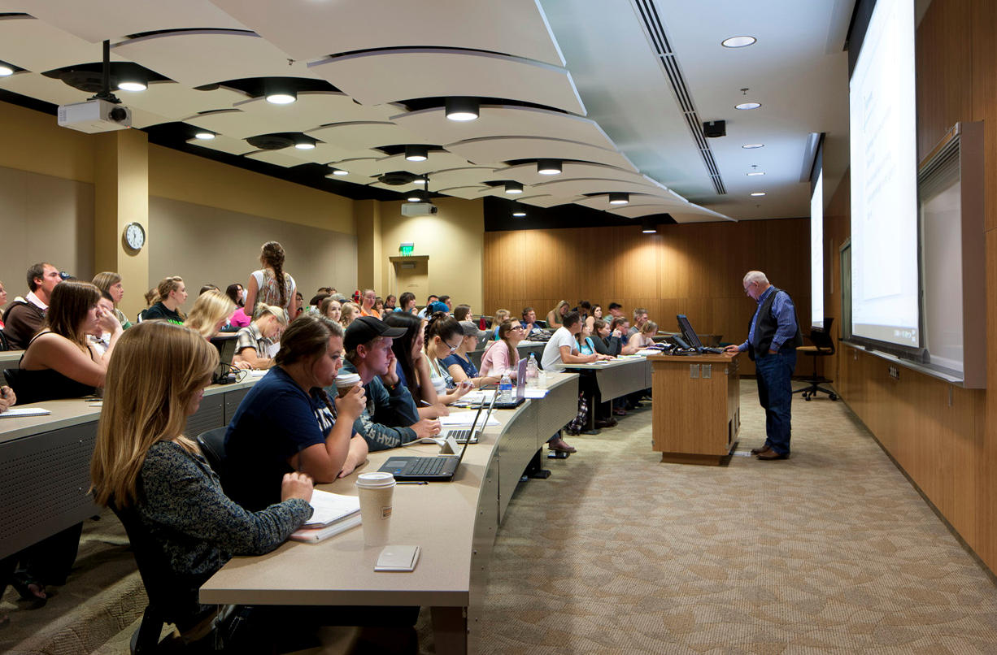
QUESTION ON THE FIRST DAY OF CLASS

Slide 5
QUESTION ON THE FIRST DAY OF CLASS
I need a class.
I like the topic.
Never had a history course; but
this is a good time in my schedule.

Slide 6
QUESTION ON THE FIRST DAY OF CLASS
This is HIST 3750.
But you’ve never taken any history surveys?
Would you sign up for CHEM 3750 without first taking 1000 & 2000 courses?

Slide 7
on the student’s mind:
the topic
the schedule
the numbers
credit load
registration requirements
financial aid conditions
grade point average

Slide 8
on the student’s mind:
the topic
the schedule
the numbers
on the Tuning faculty’s mind:
the learning
not just adequate interest, but also adequate preparation
knowledge & skills students bring to a course
ratcheting information & abilities higher
•building expertise & competency--not just credits/grades

Slide 9
on the student’s mind:
the topic
the schedule
the numbers
on the Tuning faculty’s mind:
the learning
the curriculum
• think of the class is relation to the larger curriculum
• think of the history curriculum in relation to other
post-secondary requirements
• the knowledge and “cross-cutting” skills
all components make to the meaning of the degree

Slide 10
on the student’s mind:
the topic
the schedule
the numbers
on the Tuning faculty’s mind:
the learning
the curriculum
the connections
beyond our department and our campus . . .
one way of integrating different learning initiatives

Slide 11
the learning in a major

Slide 12
the learning in a major
the learning in a degree

Slide 13
the learning in a major
key areas of
skill & know-
ledge
the learning in a degree

Slide 14
align outcomes, practices, policies
the learning in a major
key areas of
skill & know-
ledge
the learning in a degree

Slide 15
align outcomes, practices, policies
the learning in a major
key areas of
skill & know-
ledge
the learning in a degree
demonstrating achievement

Slide 16
align outcomes, practices, policies
the learning in a major
key areas of
skill & know-
ledge
the learning in a degree
facilitate transfer & mobility
demonstrating achievement

Slide 17
align outcomes, practices, policies
the learning in a major
key areas of
skill & know-
ledge
the learning in a degree
facilitate transfer & mobility
demonstrating achievement

Slide 18
above all

Slide 20
City University is committed to providing students with a quality education that develops their intellectual abilities while providing them with the skills and knowledge base they will need to successfully navigate the complexities of the 21st century.
To lead a fulfilling and successful life against a backdrop of rapidly changing global needs requires a wide range of skills and knowledge. These include the ability to think critically, to reason logically and quantitatively and to communicate effectively. In addition, it is important that everyone has an understanding of sciences that increasingly shape our environment, an awareness of the cultural movements and diversity that have shaped societies and their values, and an appreciation of the enduring arts that express, inspire and continually challenge these values.
GE, in essence, augments and rounds out the specialised training students receive in their majors by enabling them to achieve a breadth of knowledge through exposure to multiple disciplines. GE is the glue that holds disciplines together.
GE is the core of an undergraduate education. It is “general” in that GE provides students with a comprehensive educational experience and prepares them for lifelong learning; it promotes intellectual curiosity and a love of learning.
In other words, GE gives our students an EDGE

Slide 26
USU “competency” courses: complete both ENGL 2010 (Research Writing) and STAT 1040 (Introd to Statistics) Gen Ed: complete 2 of the following ANTH 1010 (Cultural Anthropology) PHIL 1000 (Introduction to Philosophy ANTH 1020 (Biological Anthropology) PHIL 1250 (Practical Logic) ANTH 1030 (World Archaeology) PHIL 2200 (Deductive Logic) ENGL 2200 (Understanding Literature) POLS 1100 (US Government and Politics) ENVS 2340 (Natural Resources & Society) POLS 2300 (Introduction to Political Theory) GEOG 1300 (World Regional Geography) RELS 1010 (Introduction to Religious Studies) GEOG 1400 (Human Geography) SOC 1010 (Introductory Sociology) ANTH/ENGL/HIST 2210 (Intro. to Folklore) Other courses may be applied upon approval of the History Department History surveys: A. Premodern History: complete 1 of the following HIST 1060 (Introduction to Islamic Civilization) HIST 1100 (Western Civ.: Ancient and Medieval) HIST 1500 (Cultural and Economic Exchange Pre-19th C World) B. Modern History: complete 1 of the following HIST 1110 (Western Civ.: Modern) HIST 1510 (The Modern World) C. American History: complete both HIST 2700 (United States to 1877 ) HIST 2710 (United States 1877-Present) Students may count more than 12 credits of lower-division coursework in History toward the history major.

Slide 27
-a major with criteria and expectations
-not just a default major – or grab bag of courses slapped together haphazardly
-one actually needs certain knowledge and competencies
-structured, sequenced, intentional, Tuned curriculum
-prepare students to succeed in upper-division courses
not simply with a sufficiently high grade, but with the knowledge
and skills they’ll need
-integrated with other academic initiatives
putting together the pieces of academic reform
-Tuned learning outcomes -DQP -LEAP initiative
-reformed College Gen Ed (Pathways) -Complete College
-VALUE -Essential Learning Outcomes
-flexible
-for transfer students, returning students
-for course “articulation”
-for faculty & advisor judgment
-problems: “counting” majors; declaring the major
-student responses

Slide 28
addresses several issues: STUDENT -succeeding in a course: students who are interested but poorly prepared -grounding for success ADMINISTRATIVE -enrollment crunch: provide sufficient range of upper-division choices to declared majors DISCIPLINARY -connecting academic initiatives substantive (not merely a procedural) connection to General Education intentional curriculum accumulation of skills/competencies – not just credits and grades, check-list of requirements sequenced/ratcheted skill levels
the role it’s played in a new and broader conception of Gen Ed in the College and — quite likely — throughout the University;
the way in which the pre-major model responds to the initial concerns that moved our department into the Tuning project back in 2009 (the “problem” faculty identified with students who did not have the knowledge, skills, and thinking necessary for success in the research capstone);
the more general complaint among faculty concerned about poor performance and preparation in upper-division courses;
the discussion of majors and Gen Ed issues in the State Tuning project;
the nature of history and Gen Ed discussions within the AHA Tuning project; and
the ways in which a pre-major speaks to larger issues of sequential and intentional curricula.)

Slide 30
“The system is working to increase participation, persistence, and completion for all of our students, particularly among minorities and returning adults. To achieve this, we concern ourselves with what happens in the classroom to engage students so that they will persist to graduation. Engagement includes the use of high impact practices, articulating for students the learning outcomes and competencies they must master along with assessments that also engage students and move them to the next level of learning. In addition, faculty are reflecting upon their own teaching practices to make then more effective, which means that students will be better prepared at graduation. Preparation includes not only general education, electives, and discipline learning, but also cross-cutting skills that business and industry leaders nationally and in Utah have said they need from our graduates. These include, but are not limited to: clear written communication, quantitative literacy, ability to work across disciplines to apply their learning to new and unscripted situations, ethical judgment, problem solving, and ability to work with other cultures. We believe that quality in teaching and learning can be achieved through intentional work by faculty to achieve student learning and mastery that prepare them for future employment and as contributing citizens.”

Slide 32
the learning in a major

Slide 33
the learning in a major

Slide 39
COMPLETION AGENDA
QUALITY AGENDA
PREPARATION AGENDA
ACCESS AGENDA
EQUALITY AGENDA
COMPETENCE AGENDA

